Slide 1
Future Funding of Victims’ Services
Evidence Gathering Exercise
Summary Report and Recommendations
10/09/2024
Ella Thomas, ella.thomas@apccs.police.uk
Kaya Remek, kaya.remek@apccs.police.uk

Slide 2
Evidence Gathering Exercise
The APCC Victims’ Portfolio conducted a joint evidence gathering exercise with the Ministry of Justice (MoJ), to support the development of the next Spending Review (SR).
The APCC shared a call for evidence across all PCCs and their offices, receiving a total of 28 responses from across England and Wales.
While we did not receive a response from every PCC, the consistency of responses, and the number received, means we are able to extrapolate a number of key themes and findings, and have developed a number of recommendations.
This exercise covered only those fundings streams from the MoJ, while the portfolio covers some funding streams from the Home Office, including the substantial Domestic Abuse Perpetrator Programme funding, this will be covered through the APCC Finance Portfolio, which undertakes SR discussions with the Home Office.

Slide 3
Funding Landscape – the ‘Cliff Edge’
PCCs receive funding from the MoJ to commission services for victims of crime.
Funding is at a ‘cliff edge’. 24/25 is the final year in this allocation round. PCCs reported that the majority of their services will end in March 24/25.
PCCs are holding financial risk. Where PCCs are holding contracts into 25/26 and beyond, they have either underwritten funds from policing budgets or specified funding is subject to the continuation of MoJ grant within contracts.
The clock to renew services before 25/26 is ticking. Offices need a minimum of 6 months to undertake a procurement exercise without disruption to service delivery. Where contracts end PCCs will undertake a ‘wind down’ of services and may be undertaking decommissioning of services before the end of 24/25.
Continuity and availability of services for victims is at risk. Should funding be reduced, PCCs may cut services resulting in fewer support options, and those victims already receiving support, needing to be transferred into alternative commissioned services. Where services are decommissioned, they may not take on new referrals after a certain time in 24/25 as part of the ‘wind down’ process.
Core Grant
Additional Funding
DA/SV funding
ISVA/IDVA

Slide 4
Funding Landscape – Multi-year (Core)
Following the commitments set out in the Victims Funding Strategy, the MoJ committed to multi-year core funding for victims.
In 22/23, and 23/24, PCCs also received an uplift to core funding.
PCCs have welcomed multi-year funding. The majority commission services on a multi-year basis. Where not the case, this is usually for the additional funding including ISVA/IDVA posts from the MoJ funding.
PCCs highlighted the benefits to multi-year funding including:
Data on trends
Extended support for victims
Experienced and trained workforce
Cost effectiveness for providers
Better financial planning
Lower administrative burden
Staff retention
Reduced waiting lists
Innovation and co-commissioning

Slide 5
Funding Landscape – Additional Funding
The MoJ provide funding for:
  ISVA/IDVA posts, via a mixture of competition and allocation.
  Sexual Violence/Domestic Abuse ringfenced funding (community grant) via allocation.
This funding has allowed PCCs to commission more services and services to take on more cases. This funding is critical for the delivery of services. The evidence for the services funded by these grants shows:
PCCs rely on the ISVA/IDVA grant
Referrals are increasing
In some areas this amounted to up to 70% of service provision for ISVA/IDVAs.
Caseloads are high
Areas reported a significant rise in referrals to ISVAs.
If the funding ends in 24/25 many posts will be lost.
Cases are complex and being held for longer, due to a number of demand factors.
Waiting times are increasing
One area noted a 25% increase in referrals from 2021-22.
Victims are waiting longer to receive specialist support from ISVAs, IDVAs and DA services.
Areas reported many ISVAs and IDVAs services are holding cases from 2 to up to 4 years.
One area reported, waiting times of up to 2 years.
We asked PCCs if the ring-fenced ISVA/IDVA funding had been wrapped up into the core grant, would they have recruited the same number of posts?
Most agreed they would have recruited a similar number of posts.
They noted the need for greater flexibility to evaluate the demand of additional services, enabling them to commission services based on local needs.

Slide 6
Future Funding - Challenges
This exercise highlighted a number of challenges to the current funding landscape which should impact any future funding decisions.
They do not exist in isolation and are interrelated with recurring elements across the themes, but can be broadly broken down into:
External drivers:
    Demand
    Funding
And the resulting impacts to:
    Commissioning
    Workforce
    Victims’ Outcomes
Demand
Funding
Commissioning
Workforce
Victims’ Outcomes
These impacts were felt across all commissioned services, delivered across the MoJ funding streams, but PCCs were clear on the impacts particularly to those areas funded through the additional funding.

Slide 7
External Drivers - System Demand
Court Backlog
Delays in court proceedings demand prolonged support from services providers for victims and survivors particularly ISVAs and IDVAs.
Caseload numbers have grown whilst accommodating those affected by the backlogs in criminal trials. ISVA referrals have increased and waiting lists are long.
Victims are spending longer periods within the criminal justice system, which is adversely affecting their emotional and physical health, and their capacity to stay engaged with the system.
‘Cost of living’ Crisis
Practically impacts a victim’s ability to access supportive and potentially lifesaving services e.g. travel costs.
Basic essentials for support services such as travel costs have increased while providers are also supporting their workforce with practical essentials as real wages are decreasing.
Mental Health and Other Vulnerabilities
Victims are presenting with increasingly complex needs, including mental health, physical and sexual health, housing, and substance abuse issues. Victims often need support for longer, require higher levels of support/more regular contact; and require additional referrals into other services.
Mental health services have lengthy waiting list or service interruptions, requiring interim support from local victims' support services.
Mental health support is often crisis-oriented and frequently lacks provisions for long-term support.
Children and Young People
Children and young people are presenting with more complex behaviours, risks, and needs emerging post-COVID 19, along with an increase in children becoming involved in crime at a younger age.
There is a demand for services for child victims of domestic abuse (Domestic Abuse Act 2021).
Emerging Threats
Increased awareness of image-based sexual abuse, such as so-called "revenge porn", sextortion and digitally-altered content known as deep fakes, is creating further demand.
Greater Political and National Focus
The political drive and focus has set increased expectations for better investigation, charging and successful prosecution of VAWG cases.
In those early Operation Soteria/Bluestone pathfinder areas, they have already seen an increase in demand.
Greater Public Awareness
Increased awareness encourages and supports more victims to report and/or seek assistance.
Other Demand Factors
Financial pressures on partners. Local Authorities are experiencing unstable finances resulting in cuts to services, and Health bodies may also struggle to co-commission due to financial pressure.
Early Custody Release Scheme.
Reduction in early interventions.

Slide 8
External Drivers - Funding
Allocation Decisions
The funding decisions may not be well explained. The funding formula, by population, does not reflect rates of victimisation and higher crime rates.
Funding is not adequately reflecting the growing demand, rising cost of living, and inflation. Multi-year funding does not have inflation built in which means PCCs are often picking up further costs.
Inflexible Funding
Ring-fenced funding may not adequately address local needs. Greater flexibility is need to address local needs effectively.
PCCs are unable to transfer underspend from one financial year into the next within multi-year grants.
Late Funding Notification
Funding from the MoJ is often confirmed late in the financial year, or in some cases into the next financial year.
Additional funding may be offered last minute, and some areas may miss out.
Late notification puts pressure on PCCs ability to strategically plan service delivery and make financial decisions.
Funding may be underutilised, as providers may be unable to effectively plan and utilise allocated funding. If delivered in single year allocations, the delivery periods become less than a year.

Slide 9
Impacts - Commissioning
PCCs are taking reputational and operational risk, decommissioning services or underwriting services from policing budgets.
The funding approach disrupts the delivery of new and innovative approaches, preventing areas from exploring and investing in promising approaches; funding may be discontinued or cut. Notable practice may not be being best utilised as a result.
Market provision may be limited, and availability of providers small. PCCs either have little choice or the funding model impacts the ability to support market growth.
Late notification on additional funding opportunities means PCCs are unable to engage in meaningful consultation and collaboration.
Reputational and Financial Risk
Collaboration
Innovation
Market Availability

Slide 10
Impacts - Workforce
Retention
Recruitment
Sustainability
Insecurity
Staff experience burnout and other ill heath due to high caseloads, vicarious trauma, cost of living concerns and job insecurity. This may contribute to higher turnover rates and increased instances of sick leave among staff.
Short term contracts are unattractive and recruiting trained staff is challenging. Training takes time and commitment, and providers are also finding it difficult to recruit volunteers.
Short term contracts and job insecurity from late funding notification means experienced staff leave for better pay and stable conditions. They may leave before the end of their contract.
PCCs are unable to confirm contracts with providers, creating insecurity and uncertainty. Where contracts continue, long term strategic planning may not be achievable.

Slide 11
Impacts - Victims’ Outcomes
Victims are receiving inconsistent support
Victims may have contact with multiple support workers as staff move on
Victims may be moved through services if they close
Victims are at risk of re-traumatisation and poor mental health.
Victims are losing confidence in the system
High caseloads vs low capacity means that waiting lists are lengthy

Slide 12

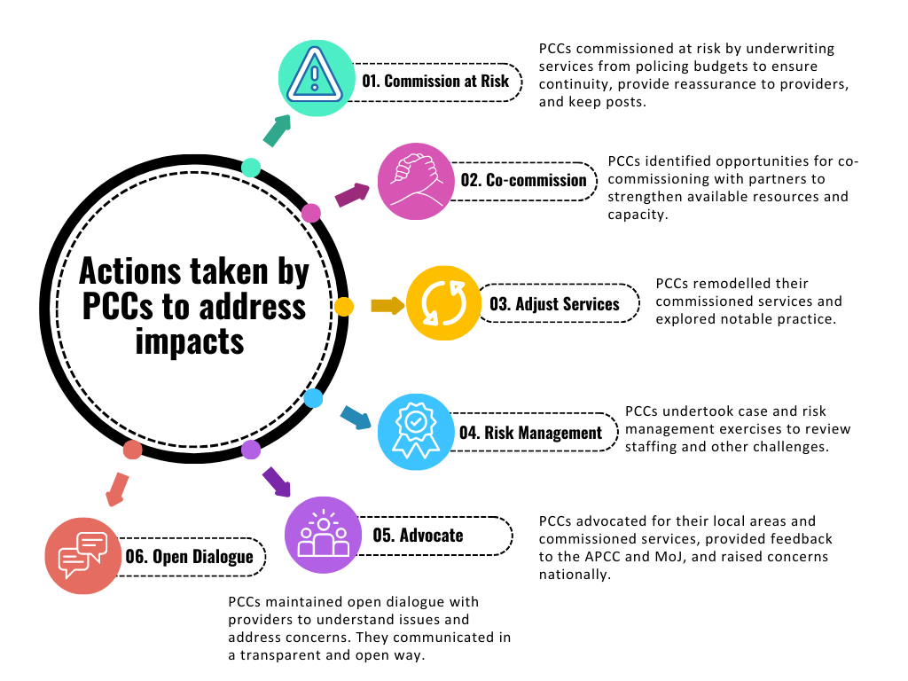
PCCs Actions – Addressing Challenges

Slide 13
Emerging Risks
In responding to the call for evidence, PCCs identified some emerging risks which may impact future demand and resource, including:
Victims and Prisoners’ Act 2024 and other new legislative duties
Increasing the roles and responsibilities on PCCs and partners, with little additional resource.
Increased use of AI
Leading to increased safeguarding concerns and new types of offences that the CJS may not have the levers or mechanisims to handle.
Standard Determinate Sentence (SDS) 40
Leading to more offenders in the community at an earlier stage, and in greater volume, and victims needing support to cope.
Procurement Act 2023
Resulting in new procurement regulations for PCCs.
Mandatory Reporting Duty for child sexual abuse
Leading to a potential increase in referrals for victims.
Manifesto Commitments
Taking away from current levels of resourcing (i.e. legal advocacy for rape victims).
These risks may also create opportunities, including an increased use of AI and technology to create efficiencies and innovations, new legislative and manifesto commitments that drive progress for victims and enhance the ability for partners to better work together locally.

Slide 14
Draft Recommendations: 1
Delivery
No. | Recommendation
1. | Funding should continue on a multi-year basis where possible. The MoJ should improve its processes to better provide early notification of grant allocations.
2. | Funding should be allocated by an assessment of need rather than competition. Competitive processes may impact on the ability of PCCs to commission strategically and effectively in response to local needs, prejudice better resourced offices, and result in delays to funding distribution with resultant impacts to delivery.
3. | Where single-year or competitive processes are necessary, the MoJ should ensure they effectively communicate eligibility, process and timely outcomes.
4. | PCCs should ensure grants are delivered on a multi-year basis, and should support providers to bid for and deliver under multi-year agreements.
Additional Funding
No. | Recommendation
5. | The additional funding from 22/23 through to 24/25, should be amalgamated with the core funding. The broad focus of this funding may be protected within the amalgamated funding to support the government’s manifesto commitments on VAWG: a) The funding should be delivered flexibly, to support PCCs to commission strategically in response to local needs. b) Ring-fencing with regard to recruiting numbers for certain roles should be removed from grant agreements to avoid constraining service delivery.

Slide 15
Draft Recommendations: 2
Overall Funding Envelope
No. | Recommendation
6. | The 25/26 + allocation calculation should take into account the inflationary and cost of living rises since 22/23 to ensure service continuity at a minimum.
7. | The 25/26 + allocation calculation should take into account the wider context of system demand for services, including the increased complexity of victims' needs, and the criminal justice system backlogs, which have led to increased demand.
8. | The 25/26 + allocation calculation should take into account the wider context of system demand for services, including the increased complexity of victims' needs, and the criminal justice system backlogs, which have led to increased demand.
Inflationary Costs
No. | Recommendation
9. | Multi-year grants should have inflationary adjustments built into the funding agreements as a standard practice.
10. | PCCs should build yearly rises into their commissioning practices, and work with providers to build this into their bids.
Commissioning Practices
No. | Recommendation
11. | APCC should develop their approach to identifying and sharing notable practice, supporting PCCs to share good commissioning practices and processes.
12. | PCCs might consider formal evaluation of commissioned services to ensure a strong evidence base for services, and that investment is well directed.
13. | PCCs might consider undertaking full victims' needs assessments to ensure commissioned services are reflective of local need.

Slide 16
Draft Recommendations: 3
Workforce
No. | Recommendation
14. | MoJ should develop a comprehensive workforce strategy that brings together the policy and funding discussions across the victims' space to manage the issues on workforce sustainability.
15. | PCCs should implement effective risk management strategies to managing the imminent risks to workforce in the short term.
New and Emerging Legislation
No. | Recommendation
16. | The MoJ, and government, should ensure that new and emerging legislation is fully funded to ensure PCCs and partners can deliver against the aims and ambitions of that legislation.
Mental Health
No. | Recommendation
17. | Victims with mental health needs should receive the correct support. The APCC should work with the NHSE to identify best practice, and to ensure guidance on practice is available to PCCs and to health colleagues.
18. | The MoJ might consider how best to reflect a requirement/working practice in the Duty to Collaborate under the Victims and Prisoners's Act 2024.

